Slide 1

Exploratory Data Analysis on Amazon Prime Video Dataset
Presented by: Dinesh S – Aspiring Data Analyst

Slide 2
Project Overview: Unlocking Prime Video Trends
Objective: Catalog Deep Dive
Key Business Questions
Analyze the Amazon Prime Video catalog to uncover key content trends and patterns, guiding strategic decisions.
Movies vs. TV shows distribution
Most popular genres and ratings
Yearly release trends and growth
Country-level content contributions

Slide 3

Understanding Our Data: The Prime Video Dataset
Source: amazon_prime_titles.csv
Size: 9,655 rows, 12 columns
Key Features: title, type, cast, director, country, rating, release_year, duration, listed_in (genres)
Time Period: Content cataloged up to mid-2021
Audience Context: Amazon Prime Video serves over 200 million subscribers globally, making content strategy crucial.

Slide 4
Data Preparation: Ensuring Robust Analysis
01
02
03
Duplication Handling
Missing Value Imputation
Data Type Conversion
Identified and removed 10 duplicate entries to ensure data integrity.
Addressed significant missing data in key columns:
Transformed release_year into an integer type for accurate chronological analysis.
Director (30%), Cast (10%), Country (10%): Filled with "Unavailable".
Rating (5%): Replaced with 'TV-MA', the most frequently occurring rating.

Slide 5

Content Breakdown: Movies vs. TV Shows
Movies
TV Shows
Analysis reveals a significant disparity: Movies dominate the catalog, accounting for approximately 81% (7,800 titles) compared to TV Shows at 19% (1,855 titles). This highlights a clear focus on film content within Amazon Prime Video's library.

Slide 6
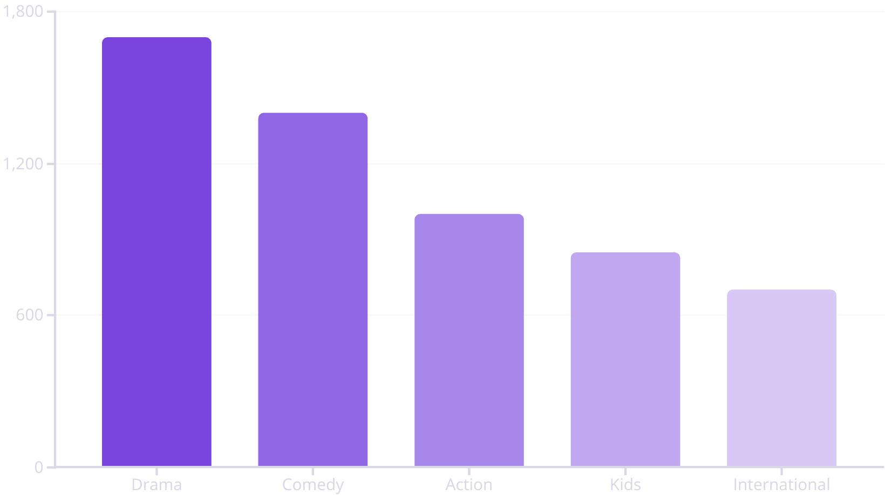
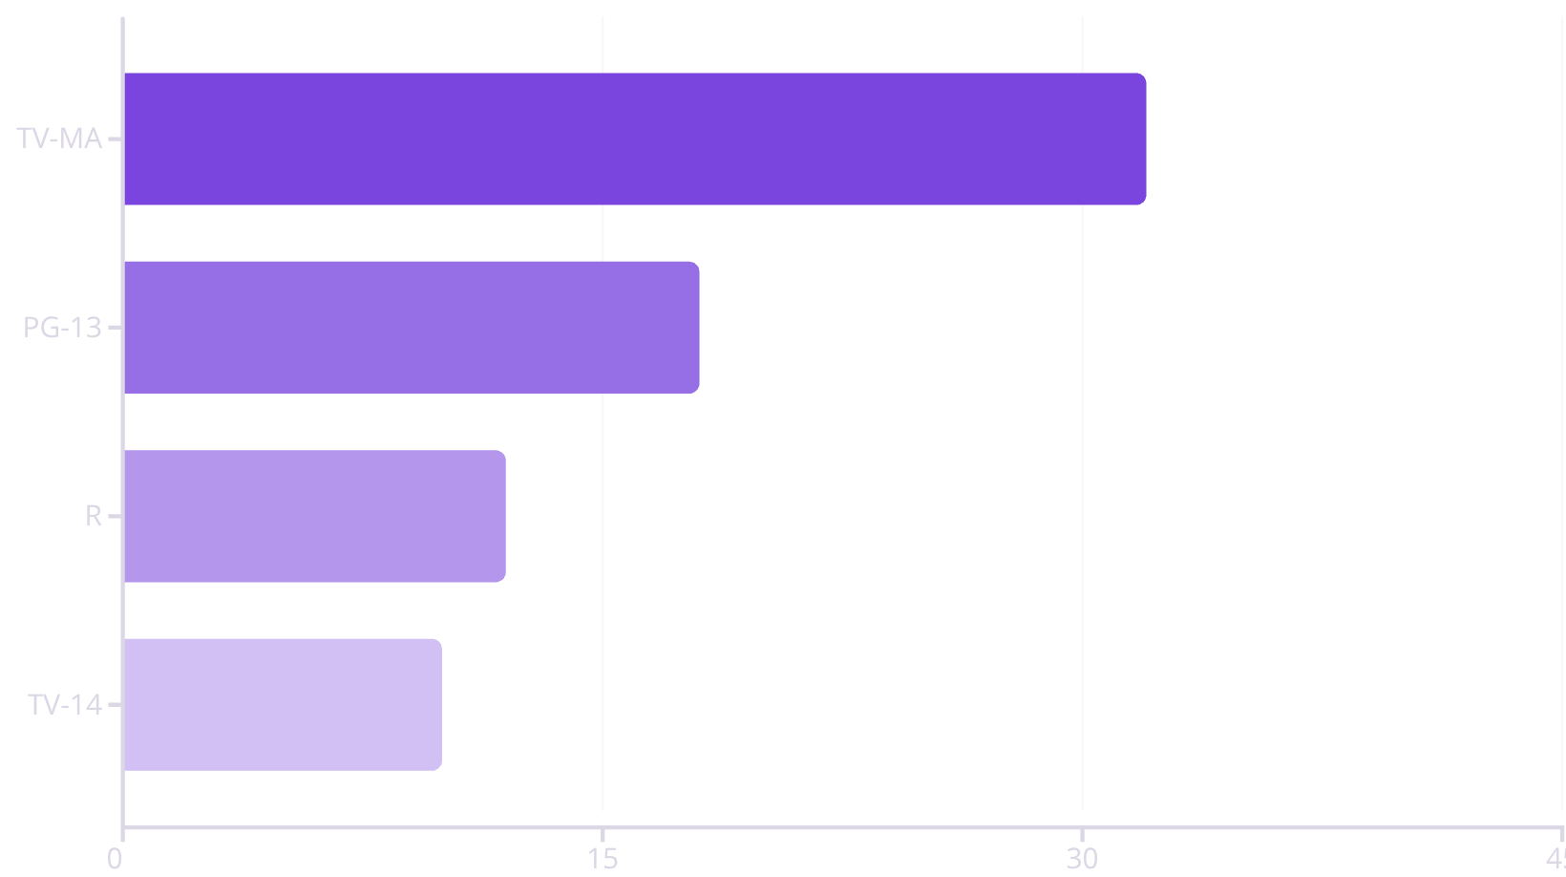
Genre and Rating Landscape
Drama, Comedy, and Action lead as the most prevalent genres, indicating a strong presence in these traditional categories.
TV-MA (32%), PG-13 (18%), and R (~12%) are the most frequent content ratings, suggesting a strong lean towards mature and young-adult audiences.

Slide 7
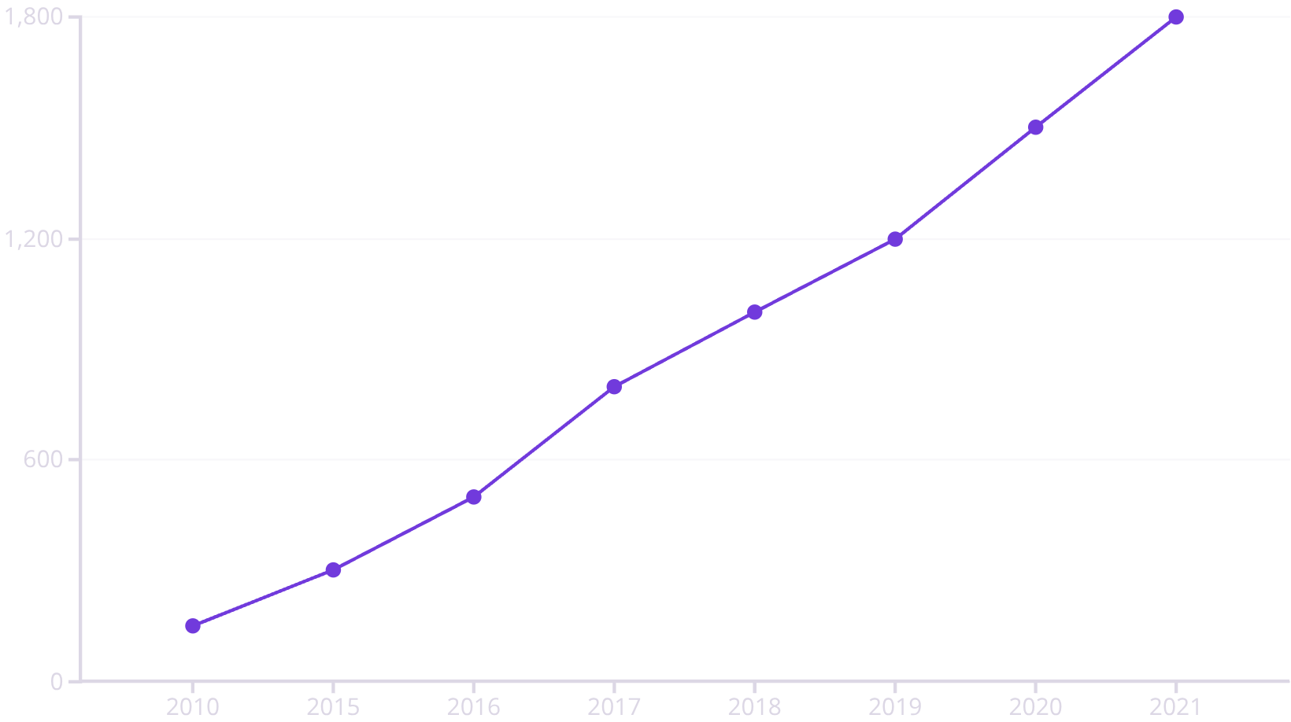
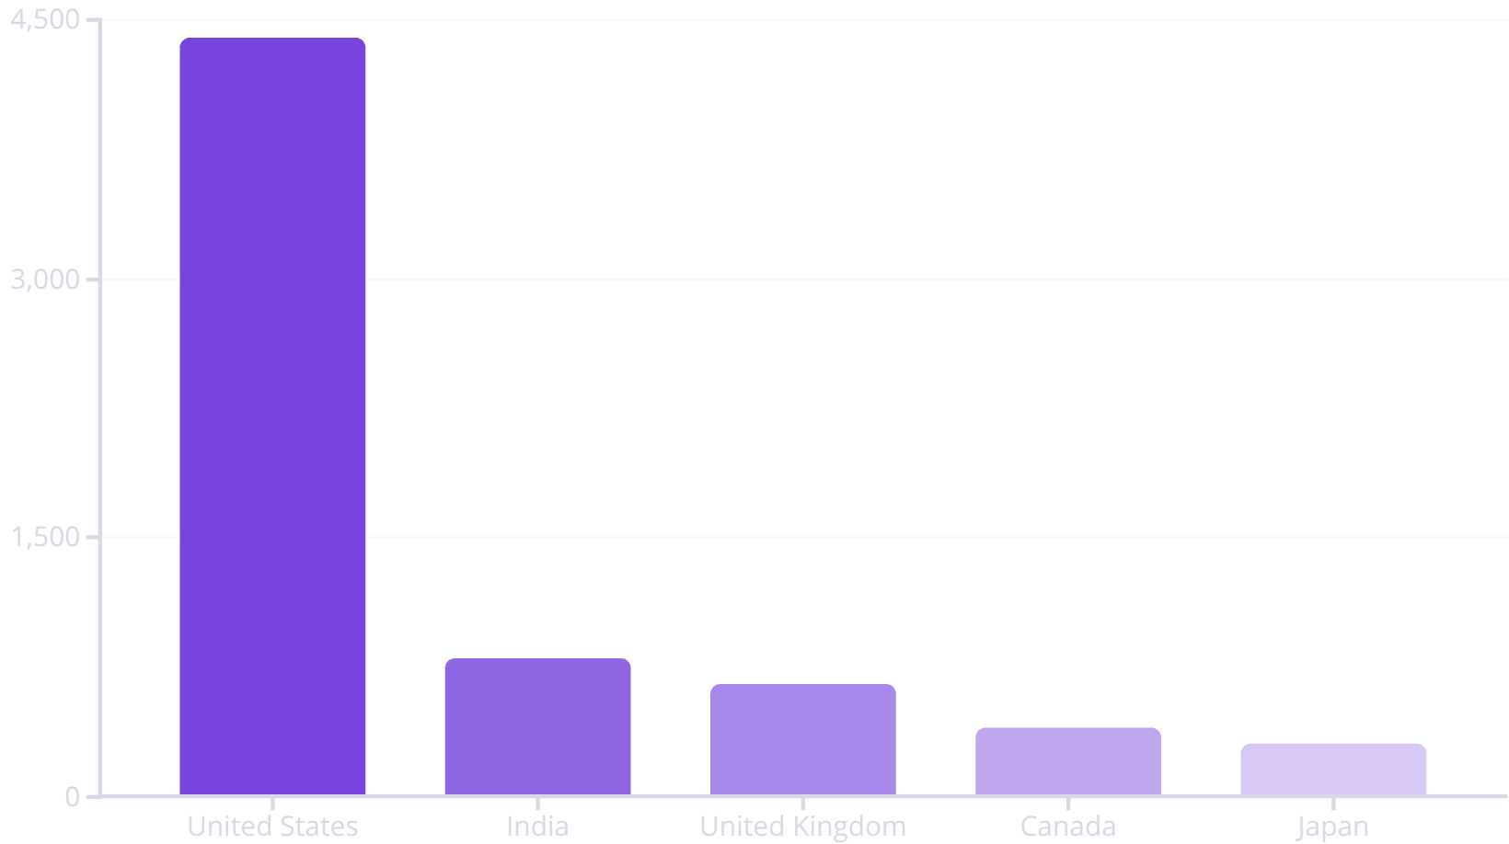
Production Trends & Global Footprint
A remarkable trend emerges with a steep growth in content releases after 2015, peaking around 2020-2021. This indicates a significant ramp-up in content acquisition and production in recent years.
The United States leads significantly in content contributions, followed by India and the United Kingdom. This reflects the primary markets for Amazon Prime Video's content strategy.

Slide 8

Strategic Implications for Content Growth
1
2
Balance TV Shows
Regional Content Investment
Opportunity to expand TV show catalog to diversify offerings and appeal to broader audiences.
Further investment in content from high-contributing regions like India, UK, and potentially Japan, to cater to local preferences.
3
4
Genre Diversification
Rating Alignment
Explore and invest in niche genres beyond the dominant Drama and Comedy, attracting more diverse viewership.
Focus on acquiring or producing more content with high-demand ratings (TV-MA, PG-13) to meet existing audience preferences.

Slide 9
Key Takeaways: Skills & Tools
Project Demonstrates:
Tools Utilized:
Data Cleaning: Proficient handling of duplicates and missing values.
Python: Core language for analysis.
Pandas: For data manipulation and structuring.
Exploratory Data Analysis (EDA): Uncovering key trends and insights from raw data.
NumPy: For numerical operations.
Matplotlib & Seaborn: For creating compelling visualizations.
Data Visualization: Translating complex data into clear, actionable charts.

Slide 10

Thank You!
Let's Connect and Discuss Data!
Feel free to reach out to me on LinkedIn!
Looking forward to connecting! 🚀

